Slide 1

School Shootings
Team members: Adriel, Jayce, William, Vivian, Christian
Notes:
Levi

Slide 2
Background on Topic Selection
Why did we decide school shootings?
Initial datasets that intrigued our group:
Education, Policing, Experiments/Social Psychology
Additional datasets we considered: Food, Media/Applications, sales (Luxury watches, top sports shoes)
Found an intersection between our interests:
Education + Policing School Shooting Data
Notes:
Levi

Slide 3
Guiding Questions: What we want to know about School Shootings
Which regions or states have experienced the highest and lowest incidences from 1999 - 2023?
How have the yearly and monthly trends of school shootings fluctuated over the past few decades, and what seasonal patterns are evident?
What are the patterns among different incidents in terms of time of day (morning vs. afternoon), and weapon type?
Are certain types of schools, such as elementary, high schools, or private institutions, more vulnerable to school shootings?
What traits are common among perpetrators (Age, gender, planned vs. unplanned, etc.)?
What risk factors or warning signs, such as history of violence, bullying, abuse, are prevalent in our perpetrators?
Notes:
Levi

Slide 4
Geographical Findings
Notes:
Jayce

Slide 5
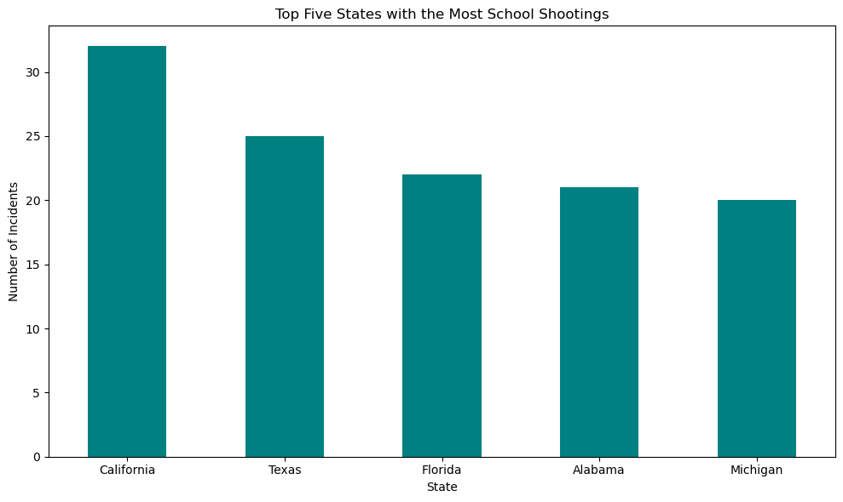
Graph of states with the most incidents
Notes:
Jayce

Slide 6
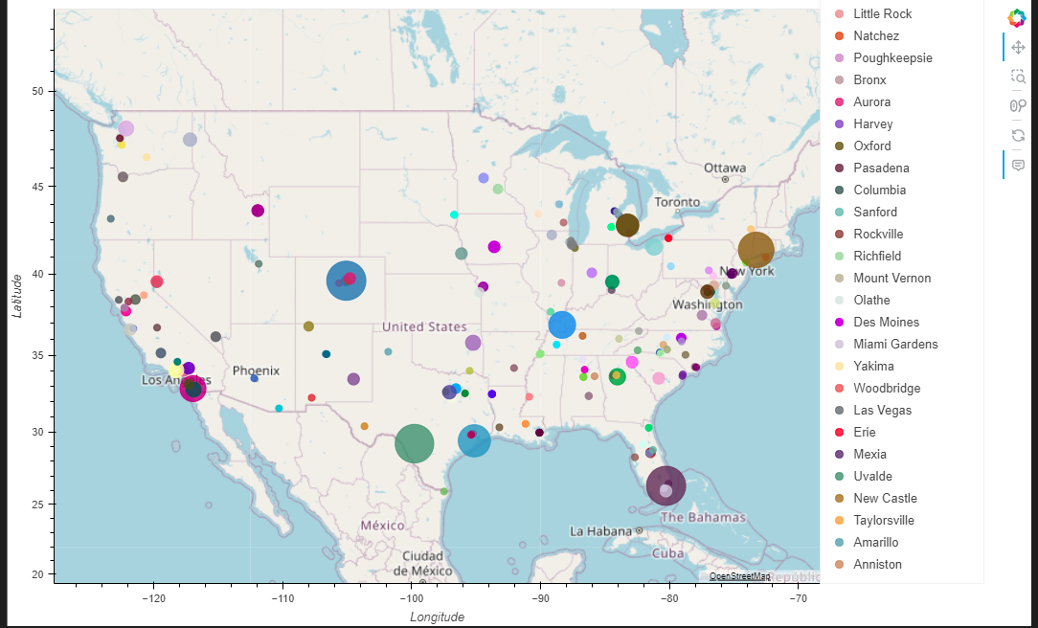
Graph of Incidents by State

Slide 7



Geographical Analysis:
Which states have the most shootings?
School shootings happen more often in California and Texas
School shootings happen less often in New Hampshire and North Dakota
Notes:
Jayce

Slide 8
Findings by Year & Season
Notes:
Vivian

Slide 9
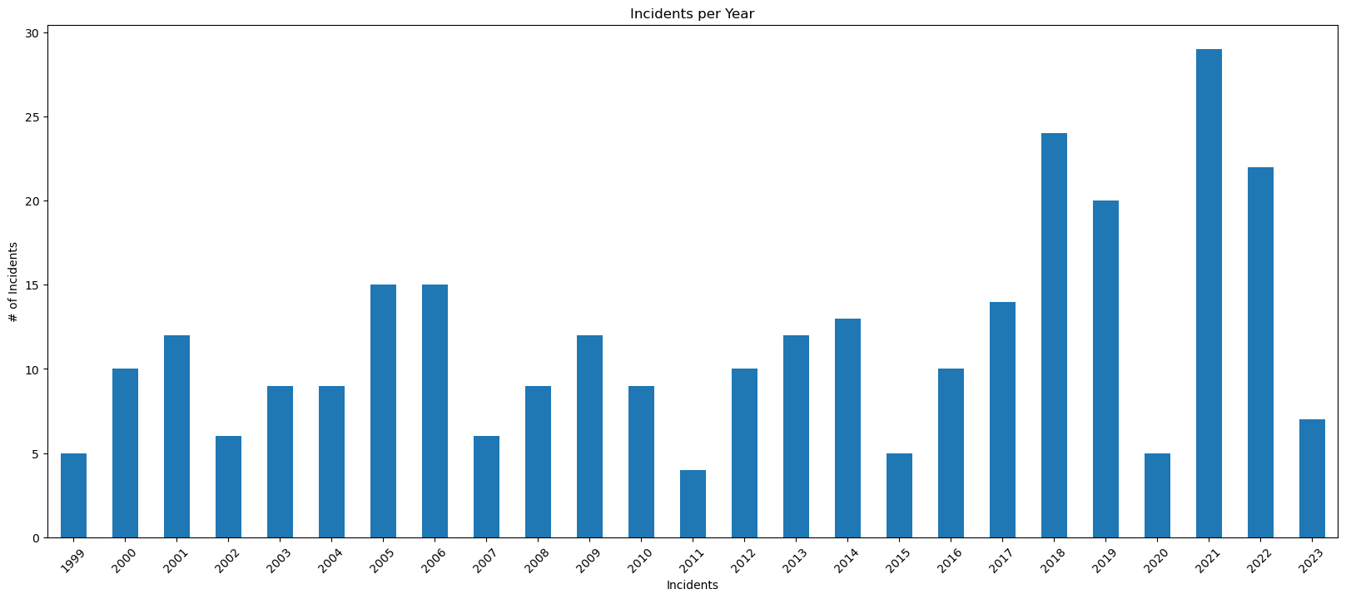
Graph of incidents by yearly trend
Notes:
Vivian
Range is from 1999-2023 (25 years)
Slightly left skewed, but at a closer look, they each have their own bell curve
The yearly trend has been increasing over time per year

Slide 10
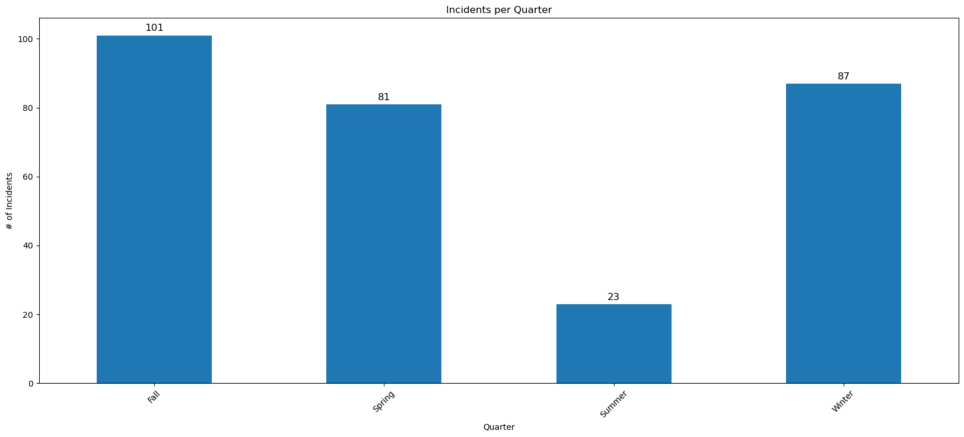
Graph by season
Notes:
Vivian
By sorting through the data, we categorized the incidents by quarter (fall, spring, summer, winter)
Over the course of these years, fall is the most common time for shootings, with winter as a runner up

Slide 11
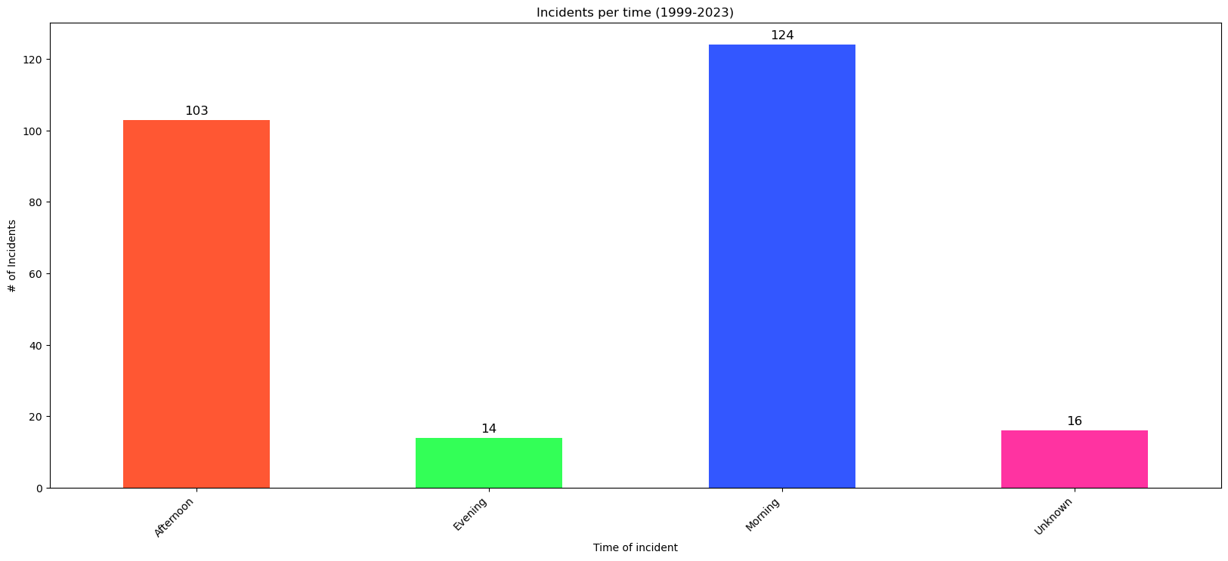
Graph of Incidents per Time of Day
Notes:
Vivian
In our data, we have columns that included the time of these incidents, we sorted into afternoon, evening, morning and we had some unknown data.
Morning is the highest and evening is the lowest
Unknown data is graphed as well.

Slide 12
Year & Season Analysis:
Have school shootings always been as prevalent?
2011 has had the lowest amount of shootings in the past 25 years.
School shootings rise and fall over the years each having their own curve.
The most school shootings happened in 2021.
The average amount of shootings has increased slightly over the past 25 years.
Over the course of these years fall is the most common time for shootings.
While the most common time for incidents are during the morning, afternoons are just as common.
Notes:
Vivian
2011 had the lowest amount of incidents
2021 had the highest amount of incidents
Incidents are increasing over time
Based on the seasonal graph, we can safely assume that summer is the lowest because a large amount of students are not taking summer classes
Seasonal depression symptoms start in the late fall or early winter and go away during the spring and summer so that is something to note and possibly make a correlation to

Slide 13
Types of School Findings
Notes:
Adriel

Slide 14
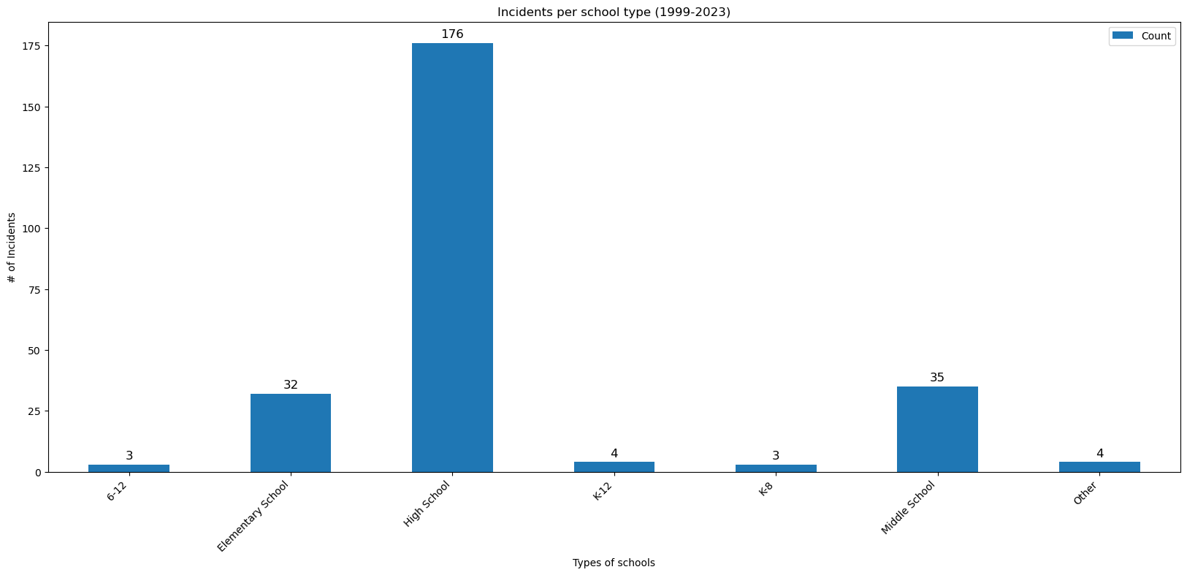
Graph of most targeted school types
Notes:
Adriel

Slide 15
Type of Schools Analysis:
What kind of schools get hit the most often?
High schools are the overwhelming majority of school types targeted.
Elementary Schools & Middle schools follow with around ~30 incidents
Combined grades, are unique, they could fall into some of these other categories but based on the grouping of grades, decided to keep them separate. Even added together, they show the smallest number of incidents.
Notes:
Adriel

Slide 16
Shooter Traits Findings
Notes:
Adriel

Slide 17
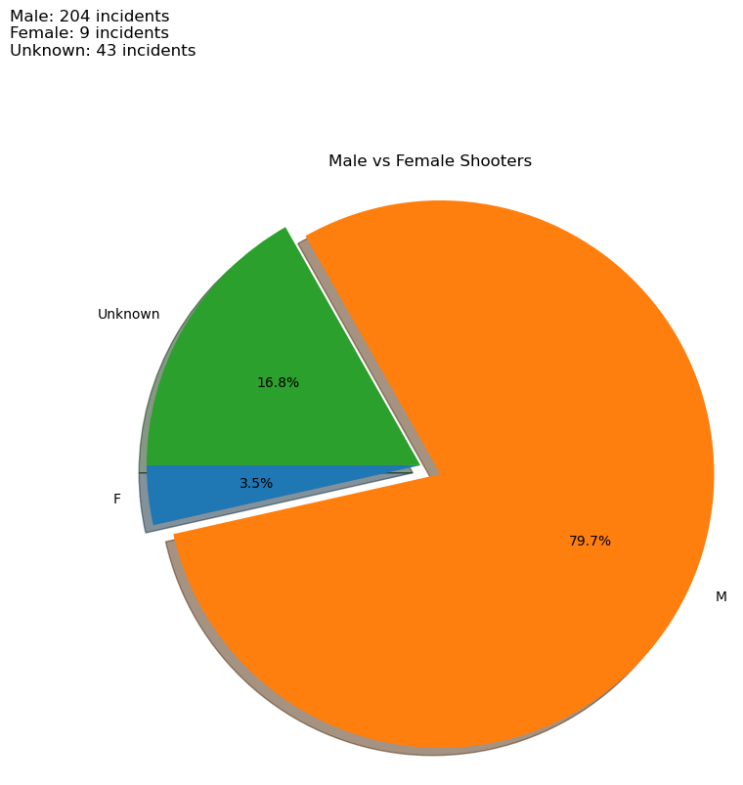
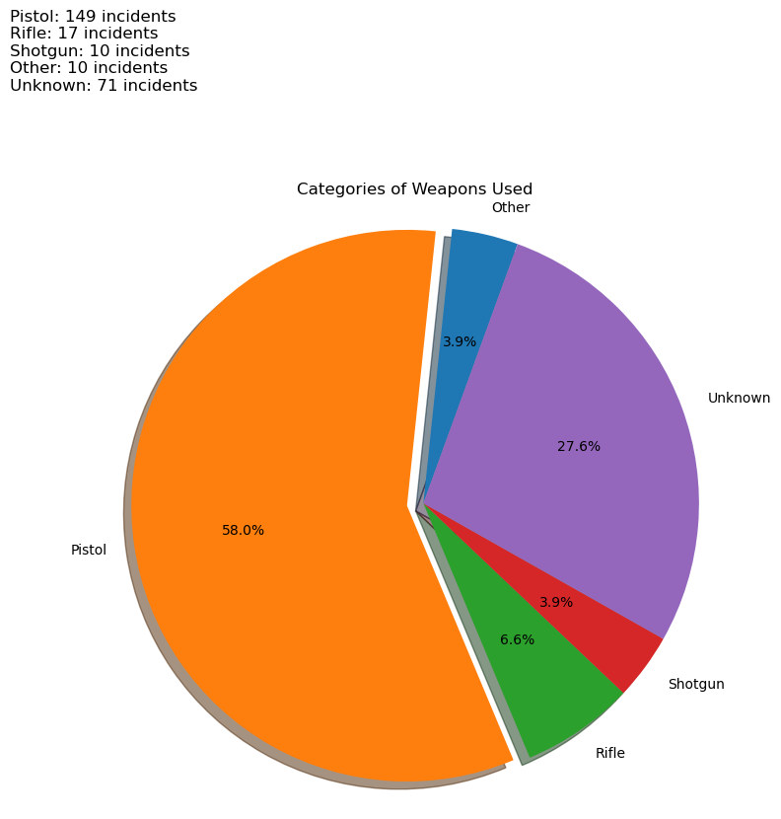
Graphs of similarities Continued
Notes:
Adriel
Talking Points:
Male vs. Female : Male overwhelming represent the majority of shooters at 79.7%
Categories of Weapons used: pistol was over half of the cases, one thing I would like to consider in future data is if there were any cases were multiple types of guns were used. Our data didn’t display this

Slide 18
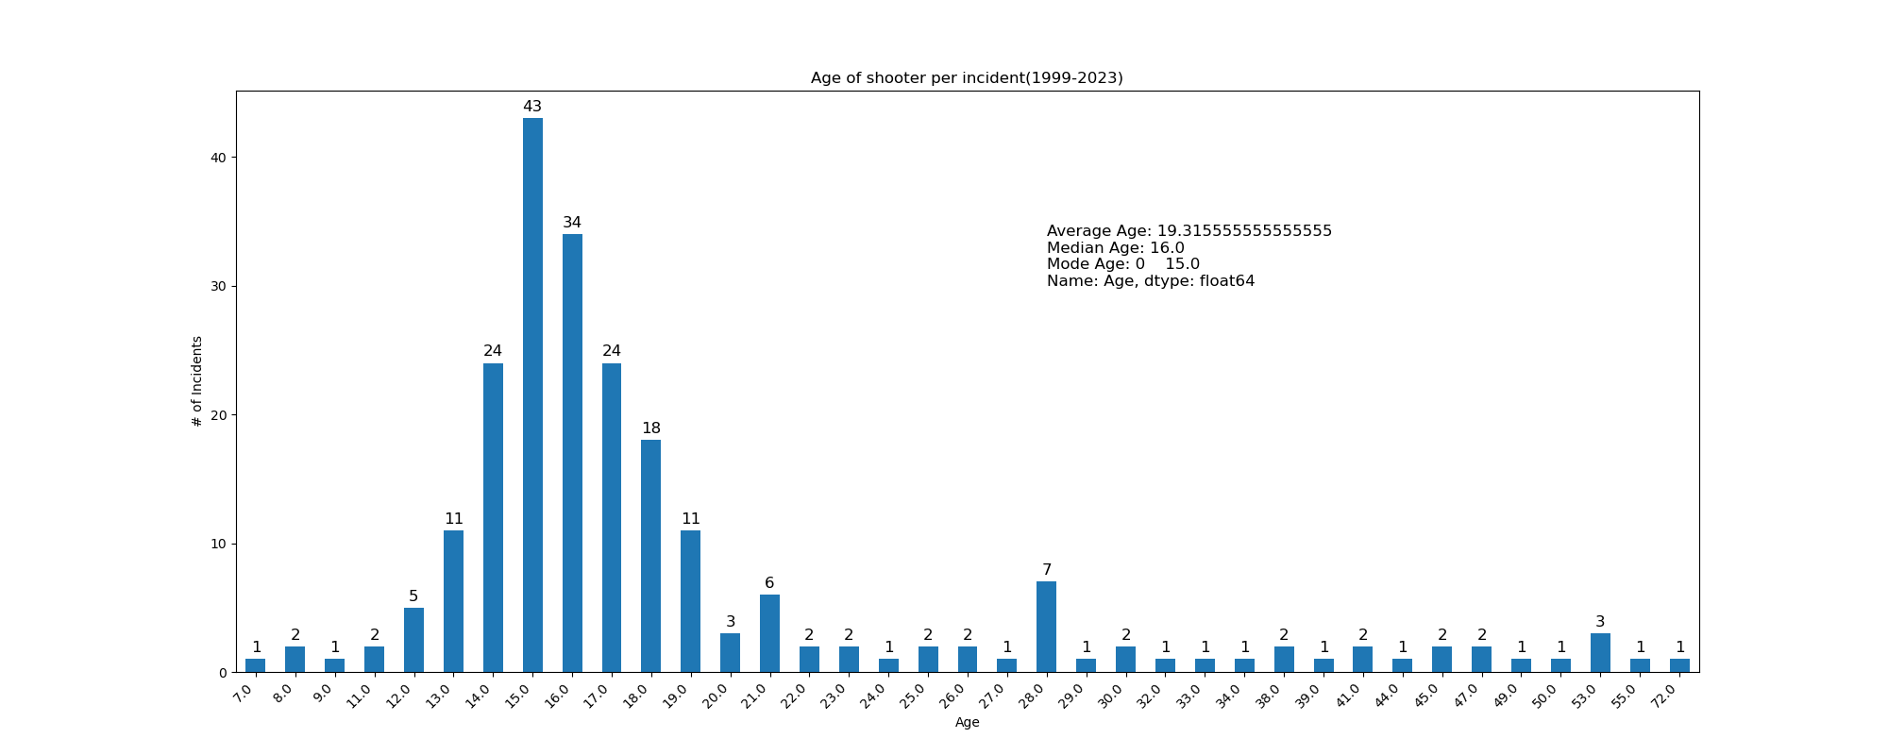
Graph indicating age of shooter
Notes:
Adriel
We can see a bell curve like distribution for the age of our shooter

Slide 19
Shooter Trait Analysis:
Are there any similarities between different shooters?
Men shoot far more schools on average than women.
Handguns are the prime weapon of choice for school shooters by over half.
Most school shooters are still teenagers the with the most shooters by incident at 15 years old.
Youngest age of shooter was 7
Oldest age of shooter was 72
Notes:
Adriel

Slide 20
Shooter History Findings

Slide 21
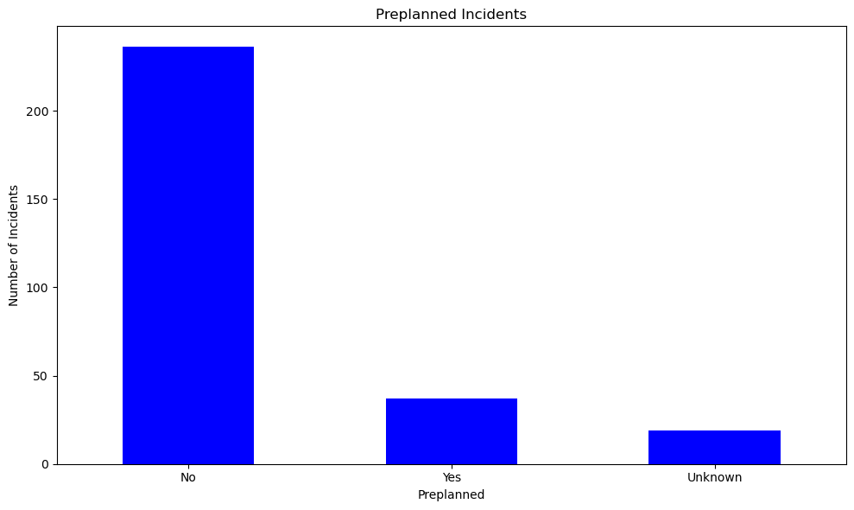
Graph of pre-planned shootings

Slide 22
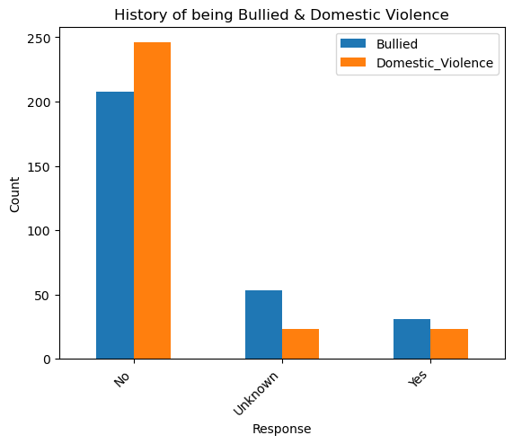
Graphs of history of being bullied and domestic violence

Slide 23
Shooter History Analysis:
Is violence common around the shooter, what is their mental state?
Data shows that most incidents are not planned out with any plan of attack, they simply walk into the school and fire looking to injure and kill.
Most shooters don't actually see violence around them as shown in the data. Most shooters are not involved in gangs, see abuse in the home, or are bullied by their classmates.

Slide 24
Wrapping Up

Slide 25
Is there anything we can do to stop/prevent these incidents?
By knowing the times when shooters are more likely to strike we can be better prepared for the worst.
By researching yearly data we can make conclusions on why some years were more safe than others.
By knowing what kinds of schools are attacked the most, we know better where to budget for security and for counseling.
Knowing that violence from the home or from outside factors does not have a meaningful factor towards shootings is a valuable wake up call.
By acknowledging the data and striving to understand more we can be better prepared to fight against school shootings.
What have we learned and how can we use it?
Notes:
Looking back
Get into relationship of shooter data
Look into data cleaning more race vs specific ethnicity column

Slide 26
Thank You

